Slide 1
Packages and Interfaces

Slide 2
Packages
Java provides a mechanism for partitioning the class name space into more manageable chunks.
This mechanism is the package. The package is both a naming and a visibility control mechanism.
You can define classes inside a package that are not accessible by code outside that package.
You can also define class members that are only exposed to other members of the same package.

Slide 3
Package
package command is first statement in a Java source file.
Any classes declared within that file will belong to the specified package.
The package statement defines a name space in which classes are stored.
If you omit the package statement, the class names are put into the default package, which has no name.
package pkg;
package pkg1[.pkg2[.pkg3]];
package java.awt.image;

Slide 4
Package Example
package MyPack;
class Balance {
String name;
double bal;
Balance(String n, double b) {
name = n;
bal = b;
}
void show() {
if(bal<0)
System.out.print("--> ");
System.out.println(name + ": $" + bal);
}
}
AccountBalance.java and put it in a directory called MyPack.
java MyPack.AccountBalance
class AccountBalance {
public static void main(String args[]) {
Balance current[] = new Balance[3];
current[0] = new Balance("K. J. Fielding", 123.23);
current[1] = new Balance("Will Tell", 157.02);
current[2] = new Balance("Tom Jackson", -12.33);
for(int i=0; i<3; i++) current[i].show();
}
}

Slide 5
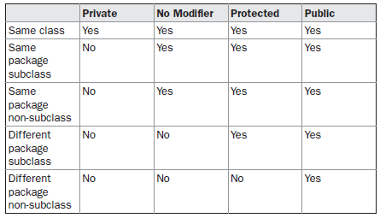
Access Control

Slide 6
Importing Packages
Java includes the import statement to bring certain classes, or entire packages, into visibility.
Once imported, a class can be referred to directly, using only its name. The import statement is a convenience to the programmer and is not technically needed to write a complete Java program
import pkg1[.pkg2].(classname|*);
import java.util.Date;
import java.io.*;
import java.util.*;
class MyDate extends Date {
}
class MyDate extends java.util.Date {
}

Slide 7
Interfaces

Slide 8
Interface
Using the keyword interface, you can fully abstract a class’ interface from its implementation.
Using interface, you can specify what a class must do, but not how it does it.
Interfaces are syntactically similar to classes, but they lack instance variables, and their methods are declared without any body.
Any number of classes can implement an interface. Also, one class can implement any number of interfaces.
Java allows you to fully utilize the “one interface, multiple methods” aspect of polymorphism.

Slide 9
Defining an Interface
access interface name {
return-type method-name1(parameter-list);
return-type method-name2(parameter-list);
type final-varname1 = value;
type final-varname2 = value;
// ...
return-type method-nameN(parameter-list);
type final-varnameN = value;
}

Slide 10
Interface
Variables can be declared inside of interface declarations They are implicitly final and static, meaning they cannot be changed by the implementing class.
interface Callback {
void callback(int param);
}
class Client implements Callback {
public void callback(int p) {
System.out.println("callback called with " + p);
}
}

Slide 11
Applying Interfaces
Refer InterfaceStack.pdf

Slide 12
Different from classes
You cannot instantiate an interface.
An interface does not contain any constructors.
All of the methods in an interface are abstract.
An interface cannot contain instance fields. The only fields that can appear in an interface must be declared both static and final.
An interface is not extended by a class; it is implemented by a class.
An interface can extend multiple interfaces.

Slide 13
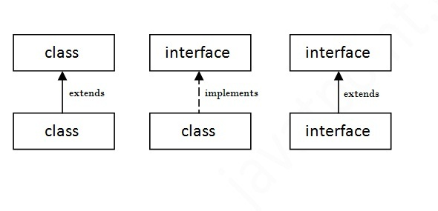
Interfaces

Slide 14
Interface inheritance
interface Printable{
void print();
}
interface Showable extends Printable{
void show();
}
class TestInterface4 implements Showable{
public void print(){System.out.println("Hello");}
public void show(){System.out.println("Welcome");}
public static void main(String args[]){
TestInterface4 obj = new TestInterface4();
obj.print();
obj.show();
}
}

